Slide 1


Best Practices in Machine Learning (Pytorch)
Content
How does a standard training routine look like
Train, Val, Test splits
Neural networks
Learning rate reduction
Reproducibility of the results
Evaluation of the model
How to better generalize: Creating synthetic Data
The idea of ResNet

Slide 2
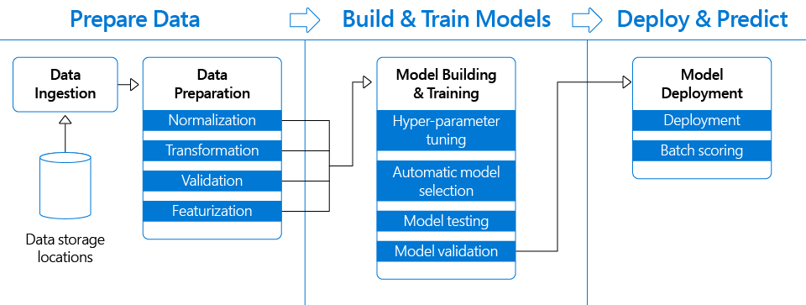
How does a standard training routine look like
https://medium.com/microsoftazure/how-to-accelerate-devops-with-machine-learning-lifecycle-management-2ca4c86387a0

Slide 3
How does a standard training routine look like
Data Ingestion and Preparation
Normalization: Min-max normalization; Z-score (https://pytorch.org/docs/stable/nn.functional.html#normalization-functions)
Transformation: Dimension reduction (Curse of dimensionality) : 1. PCA, 2. clustering, 3. feature selection
Validation: The process of ensuring data has undergone data cleansing to ensure they are both correct and useful.
Featurization: The machine learning model cannot work with raw text data directly. In the end, machine learning models work with numerical (categorical, real,…) features. Featurization is a way to change some form of data (text, image, video, etc.) into a numerical vector.
Training-testing split of the data: The data is split into 3 sets.
Model Training and Retraining
Hyper-parameter tuning: Later in the slides
Creating the network:
https://pytorch.org/docs/stable/nn.html
https://pytorch.org/docs/stable/nn.functional.html#
https://pytorch.org/vision/stable/models.html#
2. Training the network:
https://pytorch.org/docs/stable/optim.html
https://pytorch.org/docs/stable/nn.html#id1
Model Evaluation
Model testing: Later in the slides
Model validation: With testing data

Slide 4
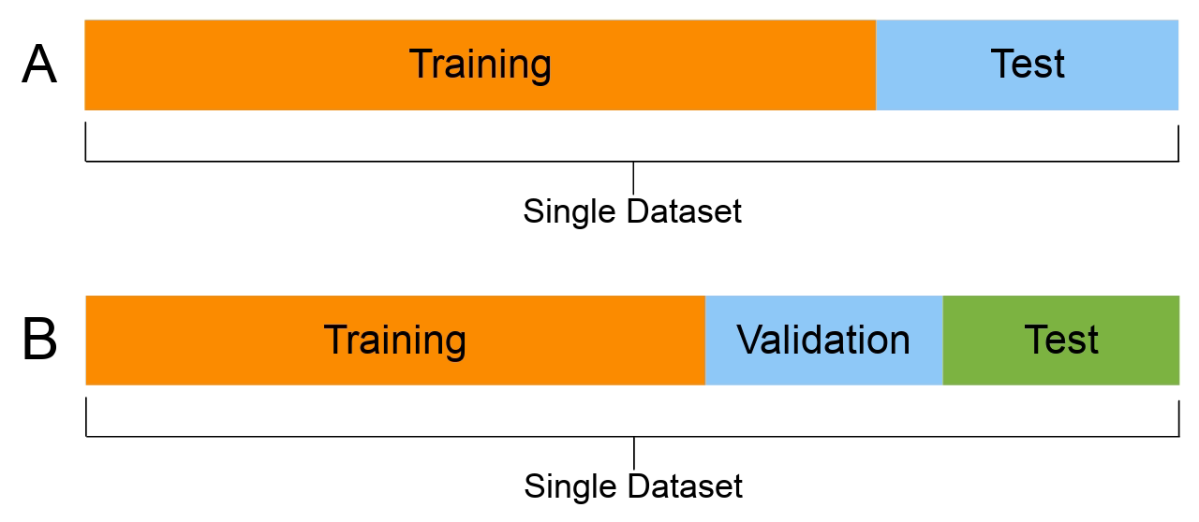
Train, Val, Test splits
Data < 1 Million
60% training set
20% validation set
20% testing set
2) Data ≥ 1 Million
98% training set
1% validation set – 10000 data
1%testing set – 10000 data
When available data is less then 1 million
Image courtesy: www.wikipedia.com

Slide 5
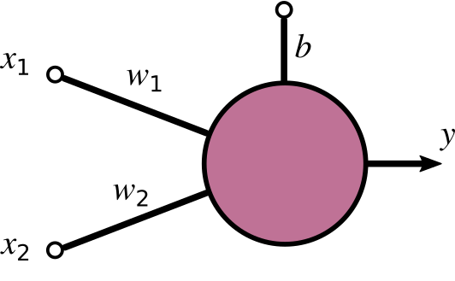
Neural network – single neuron(perceptron)
Input data
Weight
Bias
Linear regression function:
g(x) = x₁w₁+x₂w₂+b
Activation (https://pytorch.org/docs/stable/nn.functional.html#non-linear-activation-functions)
y = activation(g(x))
It introduces non-linearity to the function
“If the activation functions of all the hidden units in a network are taken to be linear, then for any such network we can always find an equivalent network without hidden units.” [9] (Bishop 2006)
output

Slide 6
Neural network – Layers in computer vision applications
Multiple perceptron neural network
https://pytorch.org/docs/stable/nn.functional.html#linear-functions
Convolutional layers
https://pytorch.org/docs/stable/nn.functional.html#convolution-functions
Pooling layers
https://pytorch.org/docs/stable/nn.functional.html#pooling-functions

Slide 7
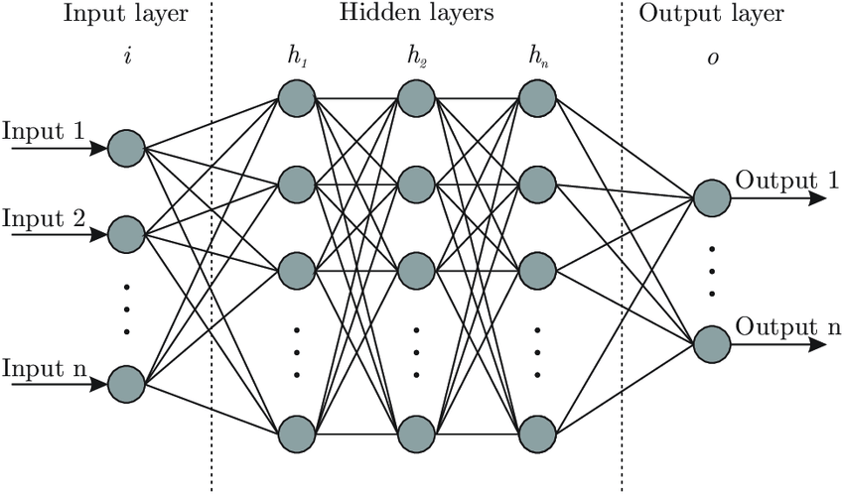
Neural network – multi layer perceptron
Input layer
Hidden layers
Output layer

Slide 8
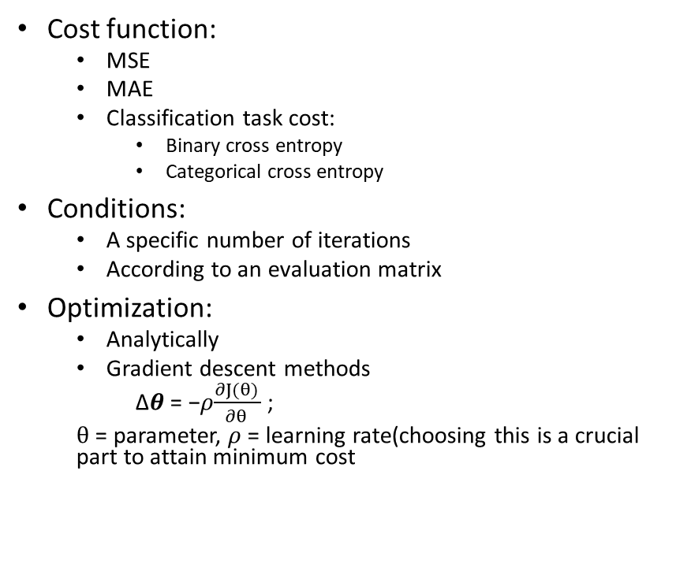
Neural network – training
How do we train the model
Psudo code:
Initializing weights and bias
Until a certain condition is fulfilled:
Calculate Forward pass
Calculate the cost (choosing cost function)
Minimizing the cost function(optimization problem)
Recalculating the parameters
Documentation of Optimization and cost function:
https://pytorch.org/docs/stable/optim.htmlhttps://pytorch.org/docs/stable/optim.html
https://pytorch.org/docs/stable/nn.functional.html#loss-functions
Cost function:
MSE
MAE
Classification task cost:
Binary cross entropy
Categorical cross entropy
Conditions:
A specific number of iterations
According to an evaluation matrix
Optimization:
Analytically
Gradient descent methods
∆𝜽 = −𝜌$\frac{∂J(θ) }{∂θ }$ ;
$θ$ = parameter, 𝜌 = learning rate(choosing this is a crucial part to attain minimum cost

Slide 9
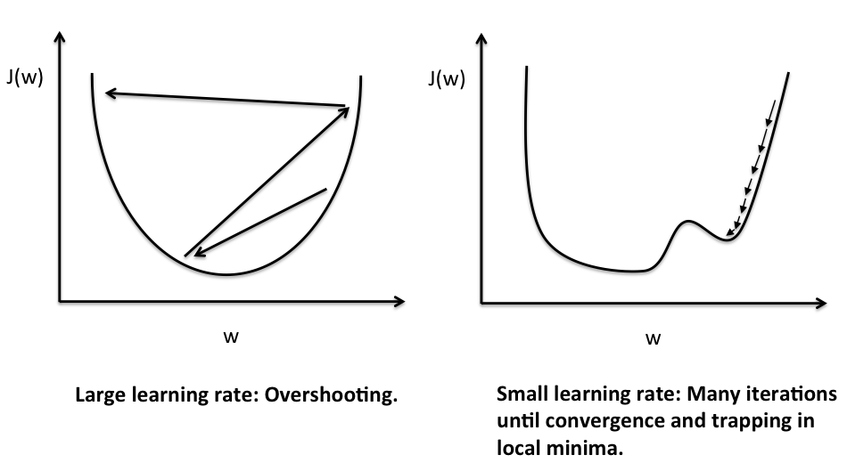
Learning rate reduction(𝜌)
Too small of a learning rate will reduce the speed of optimizing the cost function or may get trapped in the local minima
Too big of a learning rate may diverge and may not attain the minimum value (overshooting)
General value for learning rate is from 0.001 to 0.005 given the data is normalized.
https://www.google.com/url?sa=i&url=https%3A%2F%2Fsebastianraschka.com%2FArticles%2F2015_singlelayer_neurons.html&psig=AOvVaw3hmjcYnD2fHwJEZbs_1FOM&ust=1618745985049000&source=images&cd=vfe&ved=0CAMQjB1qFwoTCNDEkfSYhfACFQAAAAAdAAAAABAD

Slide 10
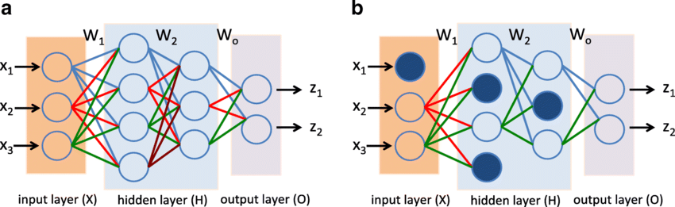
Regularization
Underfitting : Create more complex function
Overfitting : Regularization of a function
Tightens the function to not be too complex that simply performs well in the training data but predicts less accurately
Regularization : The concept of random dropout for regularization
https://pytorch.org/docs/stable/nn.functional.html#dropout-functions

Slide 11
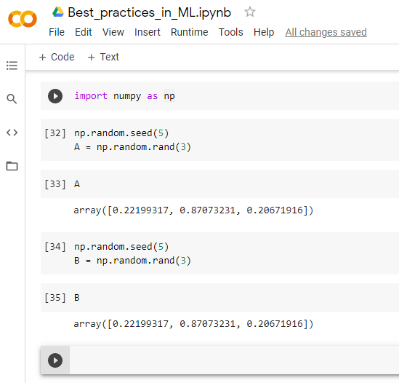
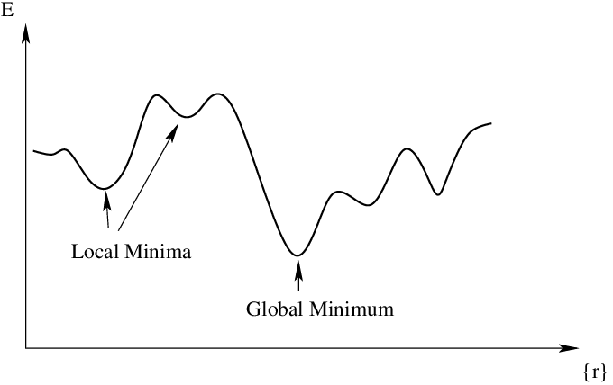
Reproducibility of the results
We can restrict sources of randomness to make the result reproducible.
While using pytorch, there are basically 3 sourcesthat needs to be controlled/seeded.
Python random inbuilt library (random.seed(0))
Numpy library (np.random.seed(0))
Pytorch library (torch.manual_seed(0))
https://pytorch.org/docs/stable/notes/randomness.html
Example of reproducibility of random numbers in numpy

Slide 12
Evaluation of the model
Comparing to human-level performance
There are 3 accuracies that needs to be considered
In statistical classification, Bayes error rate is the lowest possible error rate for any classifier of a random outcome. In most of the cases, we can consider human error and Bayes error the same as human error is very close to the bayes error.
 | Scenario A | Scenario B
Human/Bayes error | 1% error | 7.5% error
Training error | 8% error | 8% error
Development/validation error | 10% error | 10% error
 | Avoidable bias | Avoidable Variance

Slide 13
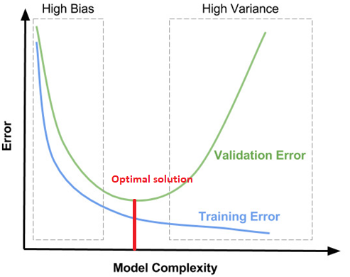
Metrics:
Confusion matrix:
Accuracy
Precision
Recall
F1-score

Slide 14
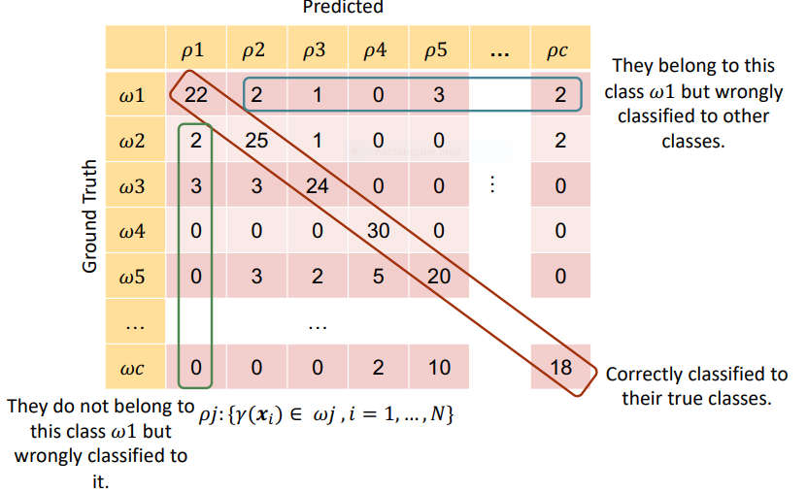
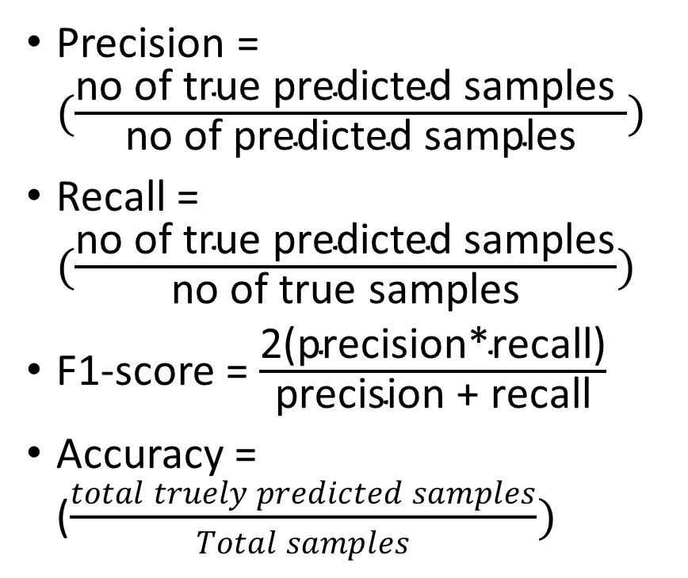
Confusion Matrix
Precision = $(\frac{\text{no} \text{of} \text{true} \text{predicted} \text{samples} }{\text{no} \text{of} \text{predicted} \text{samples}})$
Recall = $(\frac{\text{no} \text{of} \text{true} \text{predicted} \text{samples}}{\text{no} \text{of} \text{true} \text{samples}})$
F1-score = $\frac{\text{2(}\text{precision}\text{∗}\text{recall}\text{)}}{\text{precision}\text{ + }\text{recall}}$
Accuracy = ($\frac{total truely predicted samples}{Total samples})$
west.uni-Koblenz.de

Slide 15
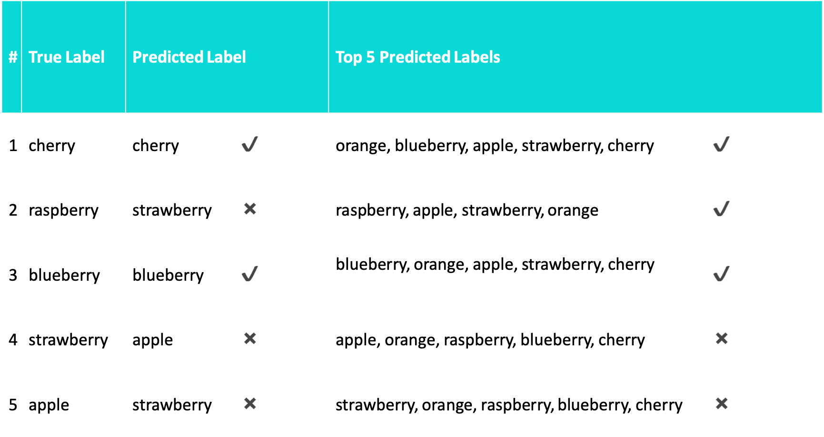
Metrics: Top 1 accuracy vs Top 5 accuracy
https://towardsdatascience.com/accuracy-and-loss-things-to-know-about-the-top-1-and-top-5-accuracy-1d6beb8f6df3#:~:text=Top%2D1%20accuracy%20is%20the,matches%20the%20single%20target%20label.

Slide 16
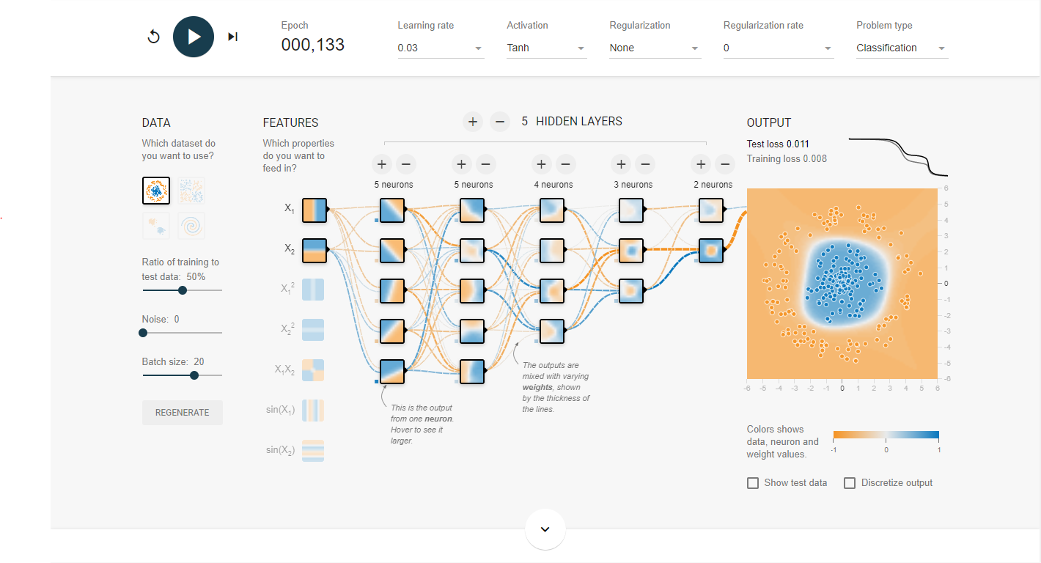
https://playground.tensorflow.org/

Slide 17
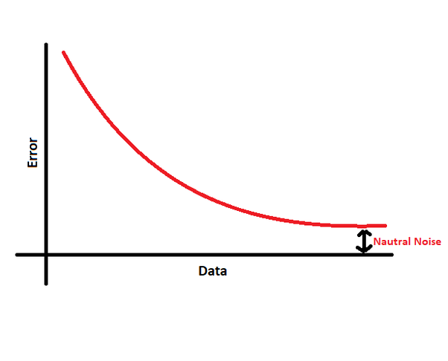
How to better generalize: Data transformation
The more the data the more accurate the model can be. We can create synthetic data from existing ones by applying some transformations on them.
The data speaks for itself.
There are vary few public datasets for specific problems.
Medical image data
The other reason to transform the data is to generalise input images
Ex. In cat classification model, input images are always at 0 degree and we might ask the model to predict a cat that is not at 0 degree
https://pytorch.org/vision/stable/transforms.html#
Transform includes:
Image dataset:
Cropping
Different types of Filtering
Rotating the data
Mirroring
Applying different types of Kernels
Normalization

Slide 18
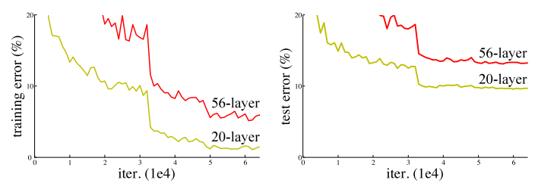
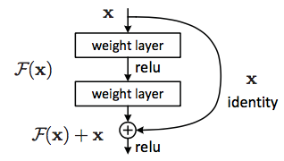
The Idea of ResNet
If the neural network is sufficiently deep, it might cause the gradient to either explode or vanish during the backpropogation.
Due to this issue, as we go deeper, the training error of deep networks are significantly higher than the shallower networks.
“In a network of n hidden layers, n derivatives will be multiplied together in the backpropogation. If the derivatives are large then the gradient will increase exponentially as we propagate down the model until they eventually explode, and this is what we call the problem of exploding gradient. Alternatively, if the derivatives are small then the gradient will decrease exponentially as we propagate through the model until it eventually vanishes, and this is the vanishing gradient problem.” – Kurtis Pykes
To solve the problem, Microsoft created Deep residual learning. The link to the paper: https://arxiv.org/abs/1512.03385

Slide 19
ResNet (Identity mapping)
No of layers | Plain | ResNet
18 | 29.94 | 27.88
34 | 28.54 | 25.03
https://swethatanamala.github.io/2018/07/09/Summary-of-resnet-paper/
The numbers in the table are top-1 error rates (in %) resulted when the models were tested on the ImageNet validation data.

Slide 20
References
https://west.uni-koblenz.de
https://playground.tensorflow.org/
https://medium.com/microsoftazure/how-to-accelerate-devops-with-machine-learning-lifecycle-management-2ca4c86387a0
https://medium.com/@aliyaser78691/featurization-f63be523644
https://swethatanamala.github.io/2018/07/09/Summary-of-resnet-paper/
https://towardsdatascience.com/accuracy-and-loss-things-to-know-about-the-top-1-and-top-5-accuracy-1d6beb8f6df3#:~:text=Top%2D1%20accuracy%20is%20the,matches%20the%20single%20target%20label
www.wikipedia.com

